Slide 1




This resource was developed by LIVE, RVC with funding from VetNetLLN
Interprofessional Skills
Vets
‘Emergency Case
Role Play’
Nurses

Slide 2
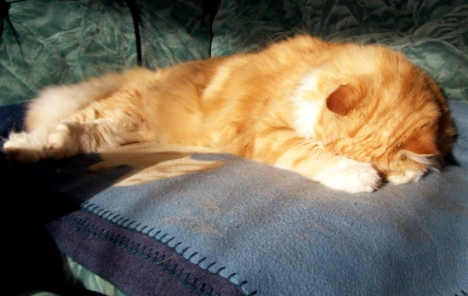
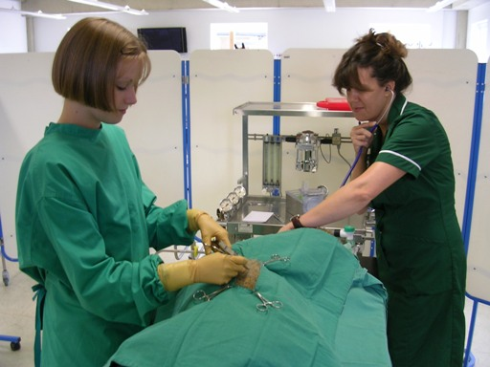
Introduction to
Interprofessional Education (IPE)
Interprofessional skills are those abilities that enable us to work with people from other professions within the veterinary practice, in order to achieve common goals such as improving the health of patients
‘Other professions’ = vet surgeons and vet nurses
In order to work well together, the professions should know about each other’s roles, abilities,
priorities etc.
IPE is increasingly being used in human
medicine, but is only starting out in
veterinary medicine

Slide 3
The Activity
Emergency Case Role Play
Or
Activity in Computer Room
1st
2nd
3rd
4th
Kate
Jane
Martin
Fiona
Kim
Sophie
Helen
Sam
Jane
Kate
Kate
Kate
Sophie
Kim
Kim
Kim
Martin
Martin
Jane
Jane
Helen
Helen
Sophie
Sophie
Fiona
Fiona
Fiona
Martin
Sam
Sam
Sam
Helen
Group Feedback, receive CPCR Flowchart

