Slide 1




This resource was developed by LIVE, RVC with funding from VetNetLLN
Interprofessional Skills
Vets
‘Talking Walls’
Nurses
RVC Project Team:
Tierney Kinnison, Perdi Welsh, Rachel Lumbis Hilary Orpet, Sue Gregory, Sarah Baillie

Slide 2
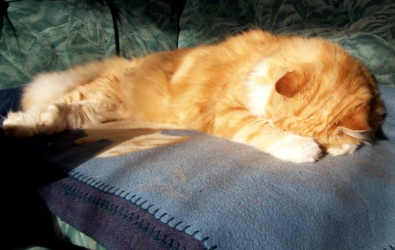
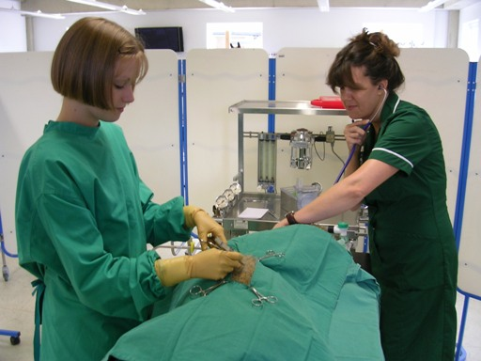
Introduction to Interprofessional Education
Interprofessional skills are those abilities that enable us to work with people from other professions within the veterinary surgery, in order to achieve common goals such as improving the health of patients
What do you, as veterinary students and
VN students, know about your own, and each other’s professions and professional roles?
In order to work well together, the professions should know about each other’s roles and responsibilities

Slide 3
Today’s Schedule
Brief overview of the ‘Talking Walls’ session
Split into small groups
Talking Walls Activity
  How to get started
  Mini-group activity
  Whole group discussion

Slide 4
Talking Walls
Aims to understand and enhance interprofessional learning – originally developed by Parsell, Gibbs and Bligh (1998)
Two Flipcharts – ‘The Veterinary Surgeon’
‘The Veterinary Nurse’
Write the roles and duties of the other
profession on their chart in blue/green/black
Go over your own profession’s chart - deleting,
amending and adding in red
Mini group discussion – creation of
misconception list
Large group discussion
15 minutes
10 minutes
10 minutes
25 minutes

Slide 5
Example of the Groups
Group A
Student 1 VS
Student 2 VS
Student 3 VS
Student 4 VS
Student 5 VS Student 6 VS
Student 7 VS
Student 8 VN Student 9 VN
Group B
Student 10 VS
Student 11 VS
Student 12 VS
Student 13 VS
Student 14 VS
Student 15 VS
Student 16 VS
Student 17 VN Student 18 VN
Group C
Student 19 VS
Student 20 VS
Student 21 VS
Student 22 VS
Student 23 VS
Student 24 VS
Student 25 VS
Student 26 VN Student 27 VN

Slide 6
Talking Walls
Aims to understand and enhance interprofessional learning – originally developed by Parsell, Gibbs and Bligh (1998)
Two Flipcharts – ‘The Veterinary Surgeon’
‘The Veterinary Nurse’
Write the roles and duties of the other
profession on their chart
Go over your own chart - deleting,
amending and adding
Mini group discussion – creation of
misconception list
Large group discussion
15 minutes
10 minutes
Write in blue/green/black
You can be both general and specific
Include all roles – even those that may be
considered the role of another profession
as well
10 minutes
25 minutes

Slide 7
Talking Walls
To understand and enhance interprofessional learning – Parsell, Gibbs and Bligh (1998)
Two Flipcharts – ‘The Veterinary Surgeon’
‘The Veterinary Nurse’
Write the roles and duties of the other
profession on their chart
Go over your own profession’s chart –
deleting, amending and adding
Mini group discussion – creation of
misconception list
Large group discussion
15 minutes
10 minutes
10 minutes
Write in red
Keep deleted items legible
25 minutes

Slide 8
Talking Walls
To understand and enhance interprofessional learning – Parsell, Gibbs and Bligh (1998)
Two Flipcharts – ‘The Veterinary Surgeon’
‘The Veterinary Nurse’
Write the roles and duties of the other
profession on their chart
Go over your own profession’s chart –
deleting, amending and adding
Mini group discussion – creation of
misconception list
Large group discussion
15 minutes
10 minutes
10 minutes
25 minutes

Slide 9

Mini Group Discussion
Points to discuss:
  Did you have any misconceptions about each other?
  Try to explain to each other why the misconceptions are not true
  How about inaccuracies and
  missing items?
Discuss

Slide 10
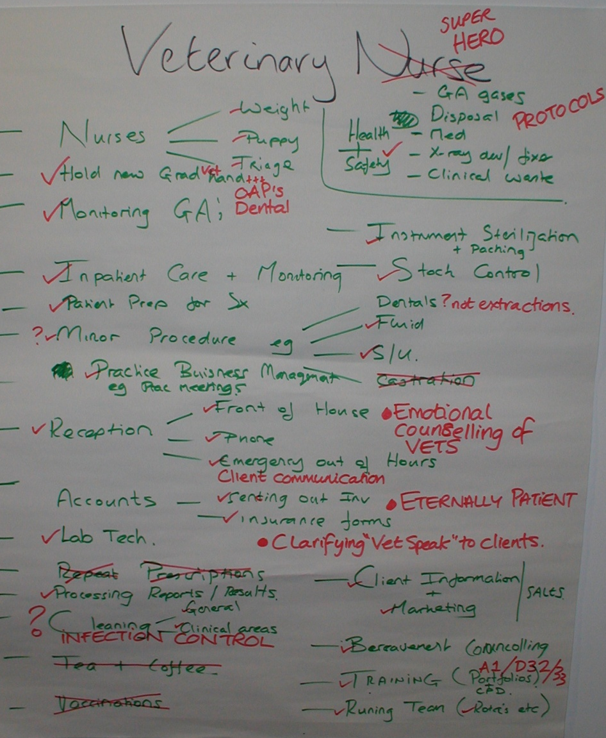
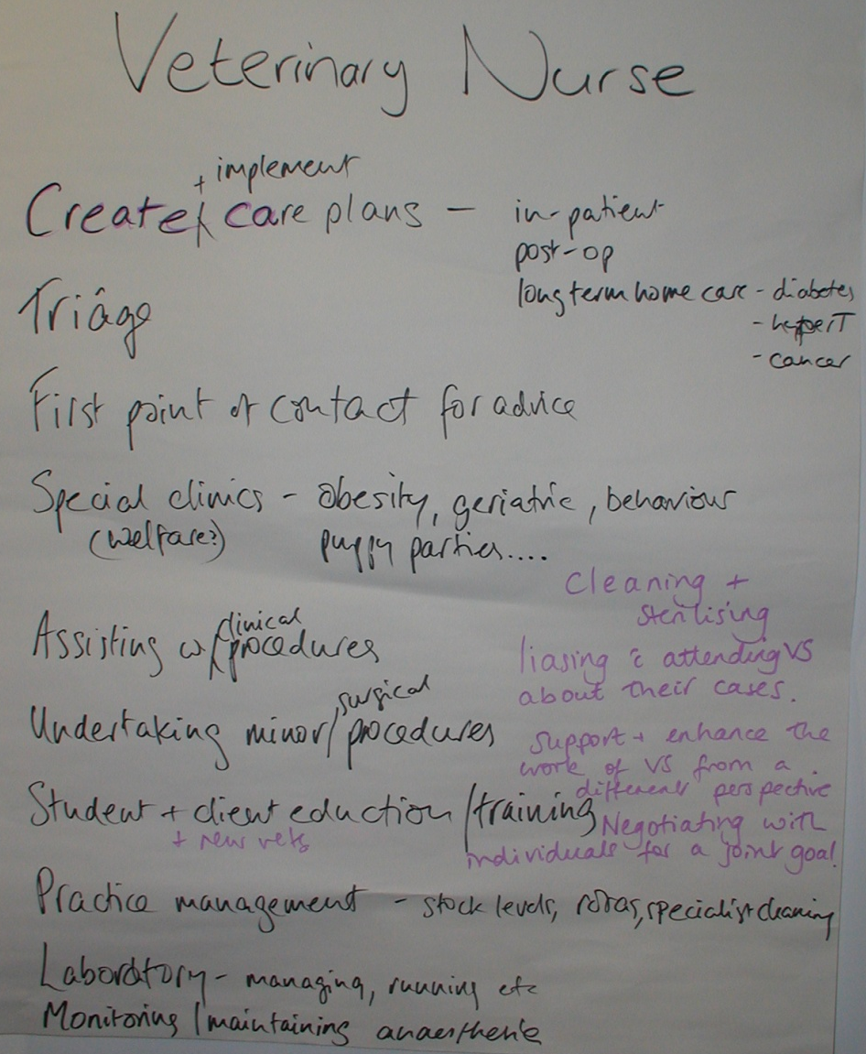
Practicing Vets’ & VNs’ view of a VN’s Role
Are these suggestions any different to yours?

Slide 11
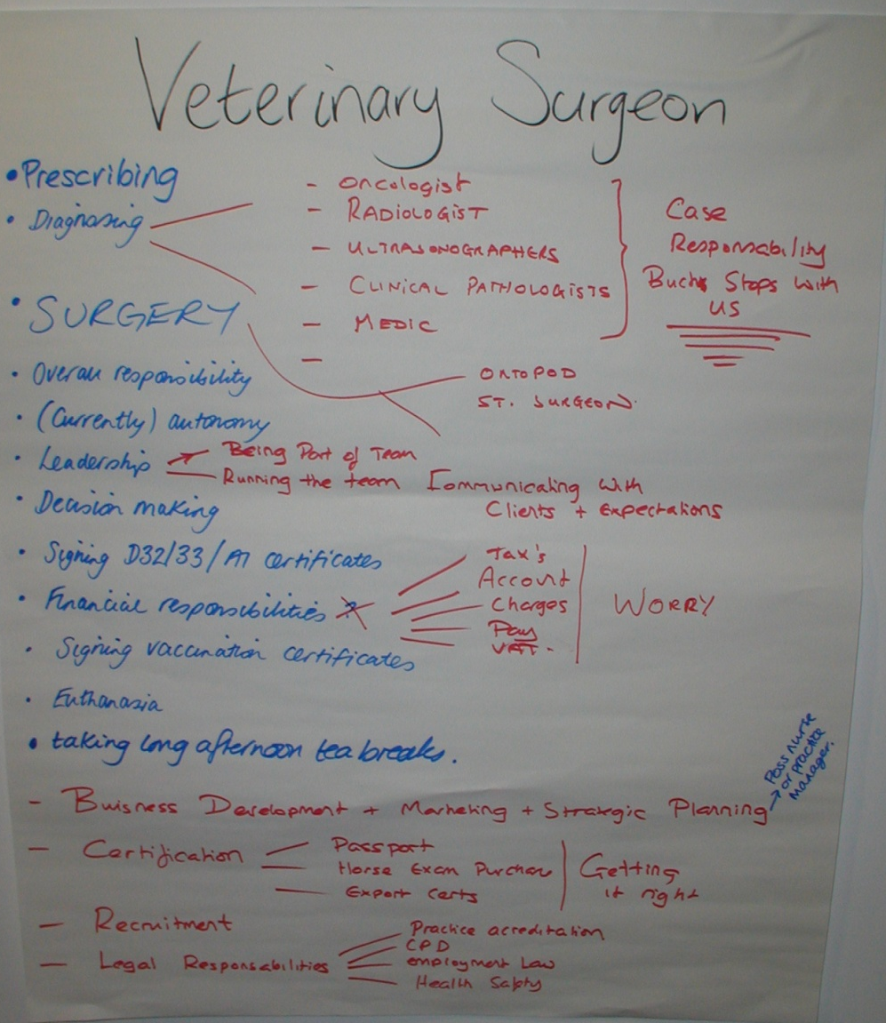
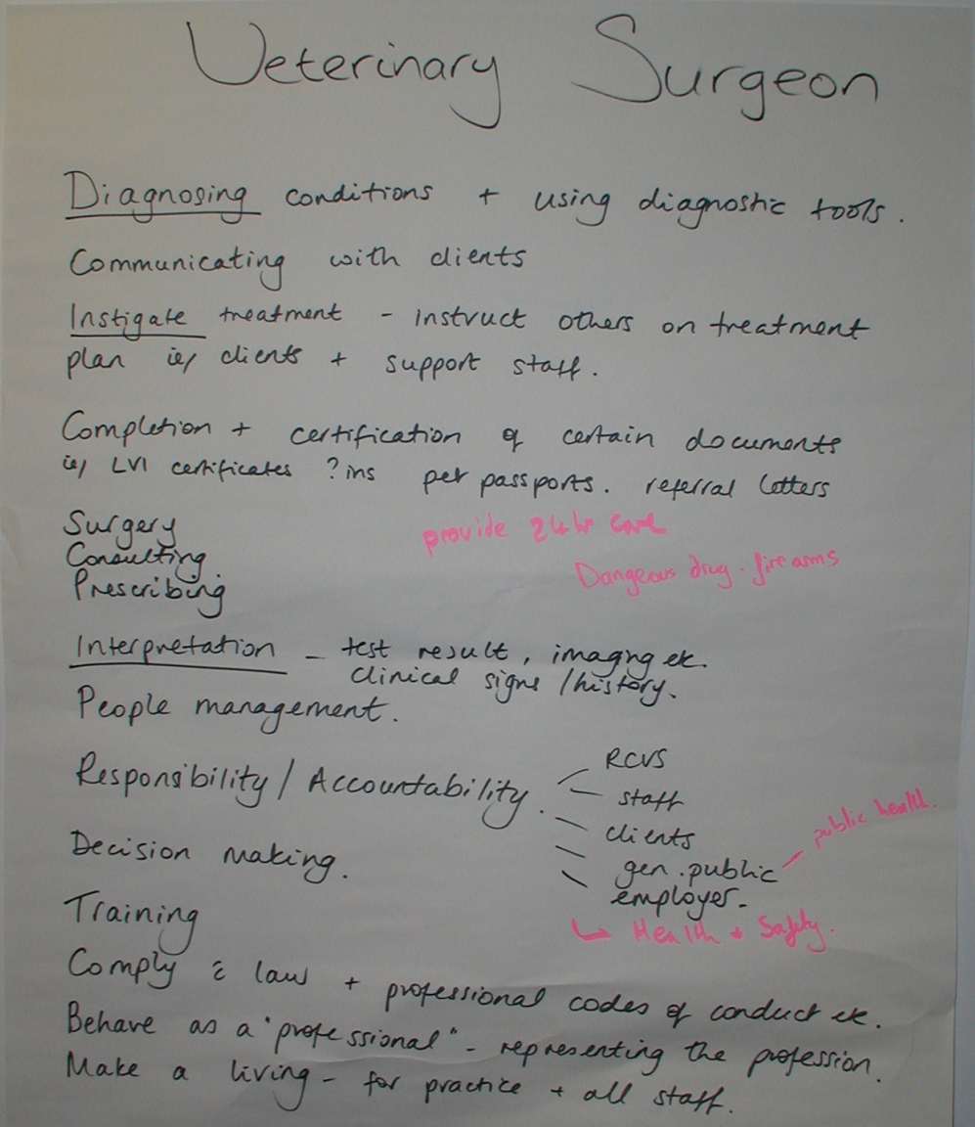
Practicing Vets’ and VNs’ view of a Vet’s Role
Are these suggestions any different to yours?

Slide 12
Group Discussion
Points to discuss:
  Consider the diversity of each profession’s role
  Do vets and VNs have many common roles and duties?
  Can you see any benefits of interprofessional education, like today’s session?

